Slide 1
What could languages ever do for me?
Chris Hughes MBE, MCIL

Slide 2
Languages – what’s the point?
Fewer people than you think are native English speakers (more speak Mandarin and Spanish…)
The satisfaction that you get from being understood (and understanding the answer!)
Language lets you into another people’s culture
You enjoy your holidays more if you can chat with the locals
They’re not just ‘another’ school subject
You’re FAR more employable in all sorts of jobs

Slide 3
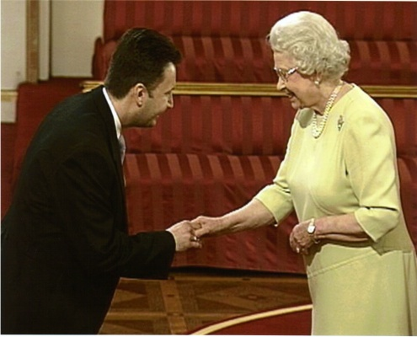
Why am I a linguist?
I’m mad about languages! (I speak 18)
I started with Spanish (before school)
Took French, German, Spanish, Italian and Latin at school and taught myself Portuguese, Dutch and Catalan
Interested in ‘rarer’ languages, so I studied Albanian and Basque
I enjoy speaking to people in their own language
I enjoy working with languages and getting paid for it

Slide 4
A tour of some languages
Je suis enchanté de faire votre connaissance.
Me gusta muchísimo hablar idiomas extranjeros.
Gostaria muito de beber uma chávena de chá.
Ich glaube, daß Sie wissen was diese Sprache ist.
Maar ik ben niet zo zeker met deze taal.
Sut dych chi heddiw? Yn dda iawn, diolch!
Shumë pak njerëz flasin këtë gjuhë.
Espainiarrek esaten ohi dute hau oso zaila dela.
نمیتوانیم این زبان را با الف بای ما بنویسیم

Slide 5





I can’t do languages. Or can I?
Facem cumpărăturile miercuri.
Hacemos las compras el miércoles.
Dat is het beste antwoord.
Das ist die beste Antwort.
Nus savain la vardad.
Nous savons la vérité.
Ne lexojmë libra.
Noi leggiamo libri.
La sortida es troba aquí.
La sortie se trouve ici.

Slide 6




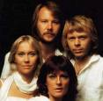
Not all pop stars sing in English!
Mi cuerpo dice quiero. Pero mi alma tiene miedo. Si me quieres junto a ti…
J’irai chercher ton coeur, si tu l’emportes ailleurs. Même si dans tes danses…
Alo? Salut. Sunt eu, un haiduc. Şi te rog, iubirea mea, primeşte fericirea...
Viernes noche, ¿a dónde ir? Todo listo para salir.

Slide 7

Esperanto in 5 minutes (1)
An entirely made up language, invented in 1887
No masculines or feminines to worry about
No irregular verbs
ALL nouns end in “-o”. ALL adjectives end in “-a”. ALL adverbs end in “-e” (lando, granda, rapide)
Present tense ends in “-as” (mi lernas)
Past tense ends in “-is” (ŝi skribis)
Future tense ends in “-os” (vi komprenos)
The word for “the” is “la”. The plural ends in “-j”.

Slide 8
Esperanto in 5 minutes (2)
Words like English: birdo, fiŝo
Words like German: tago, jaro, hundo
Words like French: ĉevalo, granda
Make things opposite with “mal-”: granda/malgranda, facila/malfacila, bona/malbona
Turn men into women with “-in”: knabo/knabino, patro/patrino, instruisto/instruistino
Make things smaller with “-et” and bigger with “-eg”: hundeto, birdego

Slide 9
Esperanto in 5 minutes (3)
Saluton! Mia nomo estas Chris.
Mi havas dek tri (dek kvar) jarojn.
Mi lernas esperanton.
Ĉu vi lernas la germanan lingvon?
Jes!
Ne, mi lernas la francan lingvon.
Gloucester estas granda urbo.
Nun mi parolas novan lingvon!

Slide 10
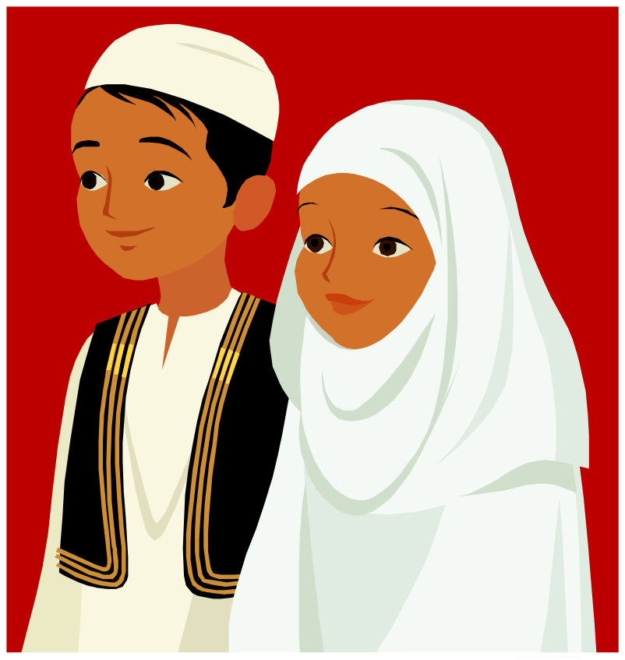
Learn a new alphabet!
کریس
گلوسترشیر
دیوید بکهم
ویکتوریا بکهم
سلام علیکم

Slide 11

My career (so far)
Degree in Spanish, Portuguese, Dutch, French and Romance languages
English teaching assistant at the ‘Escola Oficial d’Idiomes’, Elche, Spain
Teaching Portuguese to the British Consul in Rio
Multilingual translation and transcription for HMG
Wrote a book teaching Albanian and taught Albanian, Basque, Romanian, Dutch and Portuguese to the Civil Service
Columnist for a Kosovan newspaper
Examiner in Albanian and Romanian
Freelance translator, teacher, interpreter and writer

Slide 12




Can you hear similar words?
Banks
Russia
Coalition
Dollar
Martyr
Harare
Elections
Tsar
Record
Zimbabwe
Spanish
Albanian
Romanian
Persian

Slide 13

The new recruit English linguist
You’re a Martian with a new English degree
You read Shakespeare, Dickens and ‘The Times’
You can understand BBC News bulletins and ‘Downton Abbey’
You can survive as a tourist in London
You get a job with a Martian company as an English linguist
But can you … ?

Slide 14

Can you … ?
… understand ‘Neighbours’ and ‘Eastenders’ ?
… get all the jokes in a sitcom or a stand-up routine?
… see the play on words in tabloid headlines ?
(‘Super Cally go ballistic, Celtic are atrocious’
- ‘The Sun’ sports page headline after Caledonian Thistle beat Celtic at football)
… enjoy ‘Love Island’?

Slide 15

Challenges
Jargon
Place names
Acronyms
Slang
Dialects
Poor (or lack of) grammar
Swearing and bad language

Slide 16

Jargon
Military
- ‘mortar’; ‘warhead’; ‘ballistic missile’;
- ‘metralladora’ (Spanish); ‘allti’ (Albanian)
Diplomatic
- Chargé d’Affaires;Chef de Cabinet
- Pentagon; Capitol Hill; Langley
- Quai d’Orsay; Auswärtiges Amt; Cotroceni

Slide 17

Placenames
Torino, Firenze
Brugge, Luik
München, Wien
Abertawe, Baile Átha Cliath
Iruña, Donostia
Hrvatska, Shqipëria, Magyárország
Москва,中国,تهران

Slide 18
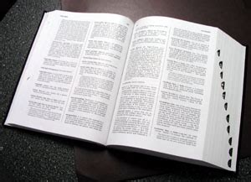
Acronyms & abbreviations
International bodies and organisations
UNHCR, OSCE, IAEA, EFTA, WHO
OKB (Albanian), AEB (Basque), OTAN (Spanish)
Military
UAV, RPG, IED
Political parties
AAK, CDU, PSOE, EAJ-PNV

Slide 19
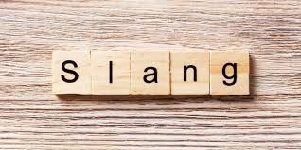
Slang
Text messaging
- CU L8R M8, LOL, IMHO/ NQS, KLM (Albanian)
Informal speech
- “I was like, yeah, and she was like, dunno...”
- “Are you up for a kick-about?”
- “He’s like so off his head.”
- “I wish he’d just do one.”
- “Gis a butcher’s, mate!”

Slide 20

Dialects
‘Standard’ Basque
‘Esan iezaiozu bi bilera igande gauean dauzkagula, mesedez’
Biskayan Basque
‘Esaiozu bilera bi domeka gabean doguzela, faborez’
French Basque
- ‘Erraiozu batzarre biga igande iluntzean ditugula, plazer baduzu’

Slide 21
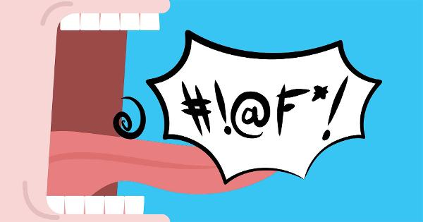
Bad language and poor grammar
‘You can whistle for it’, ‘oh dash it all to hell!’
‘Ai farë legeni m’ka shurrue me t’madhe’ (Albanian)
‘La hostia, hankan kriston mina daukat!’ (Basque)
‘I done that’, ‘he could of told me’, ‘who was them kids you was talking about?’
Good grammar – ‘ata ushtarë do t’ia japin urdhërat’
Bad grammar – ‘qata ushtarët kanë m’ja japë urdhnat’

Slide 22
Any questions?

